Slide 1

Andromada 2050
By Manoj Khatri and Eduardo Lozano

Slide 2
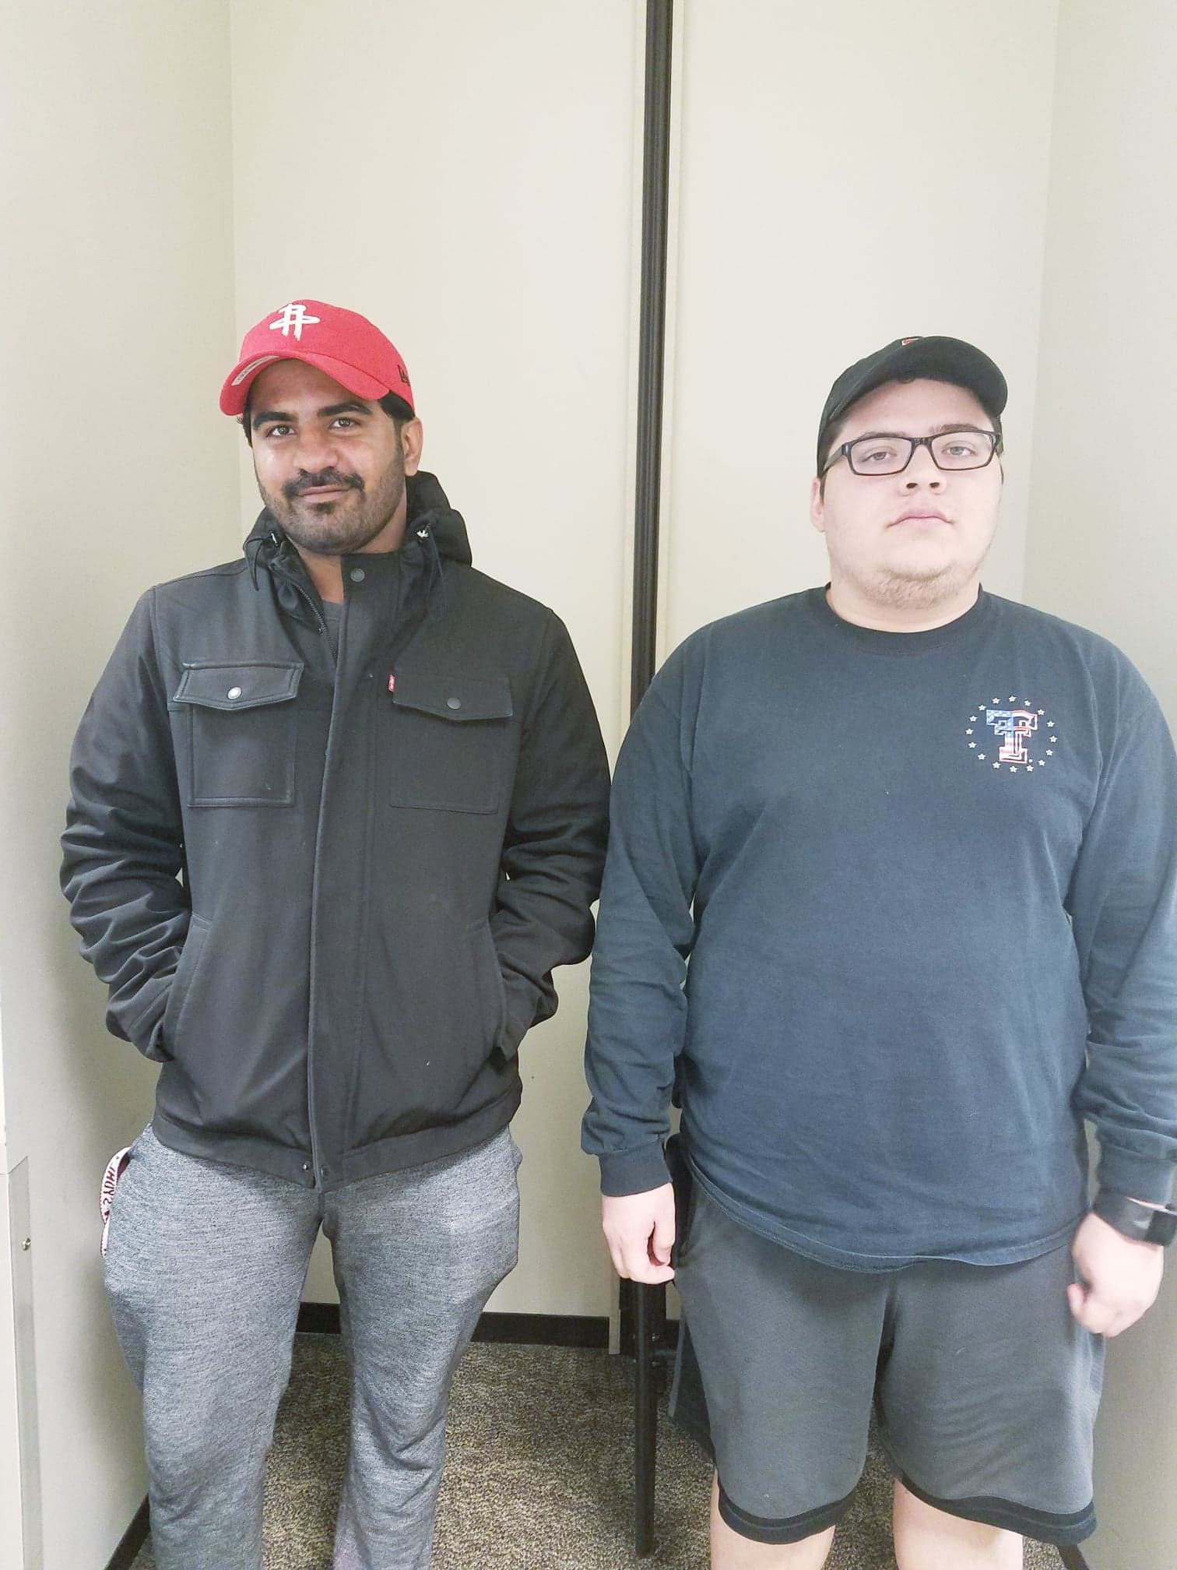

Slide 3
Description of UI
Andromada 2050 will have a space ship as a player character that can be maneuvered by tilting your body.
Player gets 4 lives and there are 2 Levels
There will be enemies who can shoot and getting shot would result in loss of one life
If all 4 lives are lost before reaching finish line you lose.

Slide 4
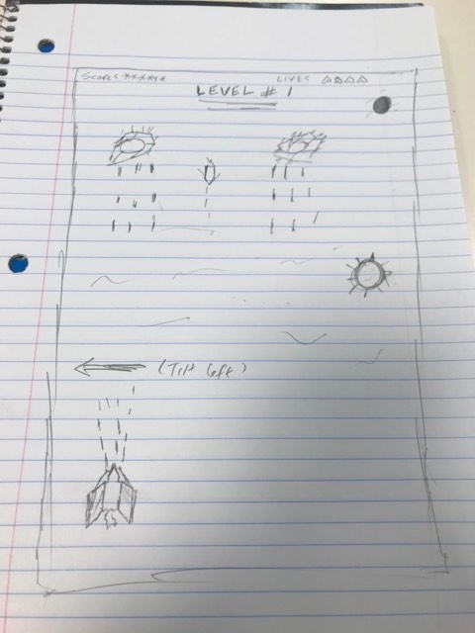

Slide 5
Our progress
Our game is at playable state by keyboard
We still need to implement the tilt feature (gesture control)
We need to come up with unique setting for our game like backgrounds and characters
Add extra features if we have time.

